Slide 1

Temporal sequence alignment for clustering longitudinal clinical data
Nuno Miguel Canhoto da Silva
80763 Prof. Susana Vinga Prof. Alexandra Carvalho
Master Project in MEIC 2019/2020 - Instituto Superior Técnico
Notes:
Vou falar de
Vamos então perceber do que se trata

Slide 2

Introduction
Partition medical data into clusters
Identify methods to evaluate the clustering result
Work will provide numerous validation metrics for clusters based on two criteria:
Intracluster compactness
Intercluster separation
Notes:
É problema pq:
Surgem muitas estruturas possiveis dos algoritmos de clustering e é preciso escolher
Agglomerative clustering no AliClu
-

Slide 3
Work from aliclu by Kishan rama
Background
Application
Electronical Medical Records (EMR) are more available now
Data from EMR can help specialists
Structures or models can be extracted from the data
Use Temporal Needleman-Wunsch (TNW) to align data sequences and obtain a distance matrix
Hierarchical clustering is applied to the TNW sequences
Apply clustering validation
Notes:
Projeto parte do que já foi feito pelo AliClu
Ponto de partida:
- Os dados do EMR podem ajudar os especialistas a melhor tratar os pacientes. Através das estruturas e modelos que podem ser extraidos dos dados.

Slide 4
OBjectives
Gather and analyse existing metrics for cluster validation
Continue and improve AliClu

Slide 5
Related Work
Methods of Evaluation
External Clustering Validation Measures
Internal Clustering Validation Measures
Relative Clustering Validation Measures

Slide 6
Methods of evaluation
Comparison of two different partitions
Generated by the clustering algorithm
Generated from a subset of the data
External
Tests the clustering result against the data itself
Internal
Comparisons of partitions generated by the same algorithm but with different parameters or from different subsets of the data
Relative
Author(s):
Sergios Theodoridis et al.

Slide 7
Related Work
Methods of Evaluation
External Clustering Validation Measures
Internal Clustering Validation Measures
Relative Clustering Validation Measures

Slide 8

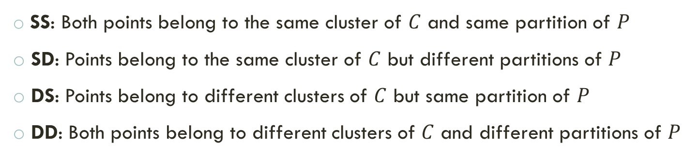
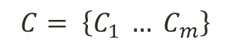
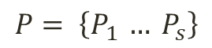
External clustering validation measures
Repeat M times
Clustering Algorithm
Subset of the data
$$C= \left\{C_{1} … C_{m}\right\}$$
Consider $\left(x_{v}, x_{u}\right)$from the dataset
$$P= \left\{P_{1 }… P_{s}\right\}$$
SS: Both points belong to the same cluster of $C$ and same partition of $P$
SD: Points belong to the same cluster of $C$ but different partitions of $P$
DS: Points belong to different clusters of $C$ but same partition of $P$
DD: Both points belong to different clusters of $C$ and different partitions of $P$
Author(s):
Hui Xiong et al.
Notes:
Comparando cada par do dataset, Podemos classificá-lo em 4 tipos, dependendo se pertence ao mesmo cluster e/ou à mesma partição.
Para ter um teste estatistico valido, devemos usar uma técnica Monte Carlo, repetindo M vezes o procedimento.

Slide 9
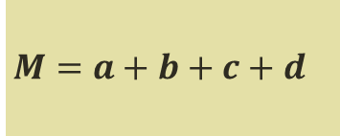
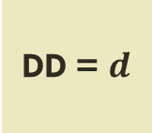
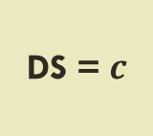
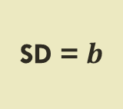
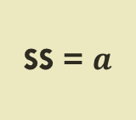
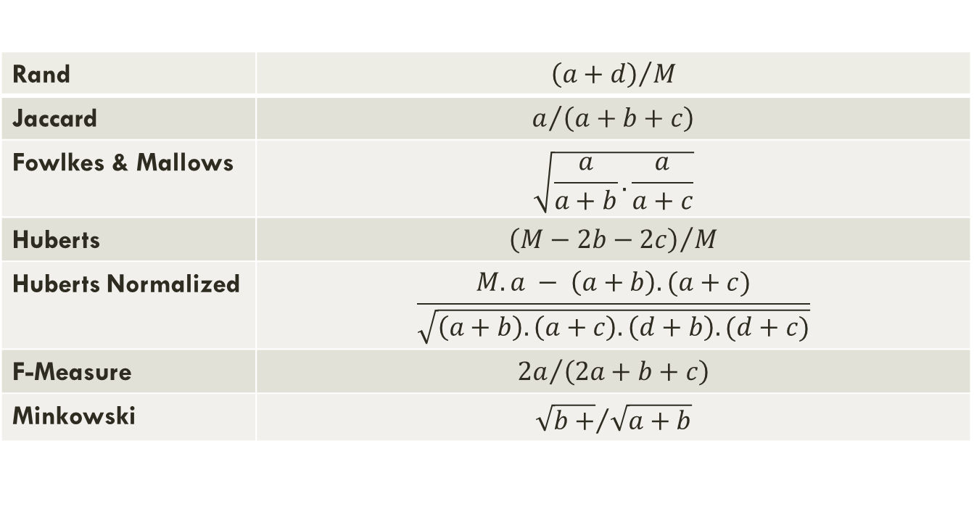
External clustering validation measures
SS = $a$
SD = $b$
DS = $c$
DD = $d$
$M=$ $a+b+c+d$
Rand | $${\left(a+d\right)}/M$$
Jaccard | $$a/{\left(a+b+c\right)}$$
Fowlkes & Mallows | $$\sqrt{\frac{a}{a+b}.\frac{a}{a+c}}$$
Huberts | $${\left(M−2b−2c\right)}/M$$
Huberts Normalized | $$\frac{M.a − \left(a+b\right).(a+c)}{\sqrt{\left(a+b\right).\left(a+c\right).\left(d+b\right).(d+c)}}$$
F-Measure | $${2a}/{\left(2a+b+c\right)}$$
Minkowski | $${\sqrt{b+}}/{\sqrt{a+b}}$$
Author(s):
Hui Xiong et al.

Slide 10
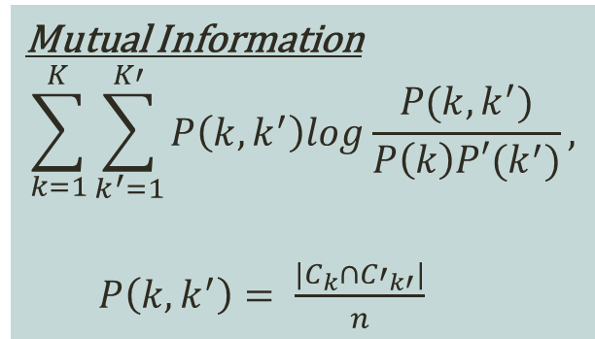
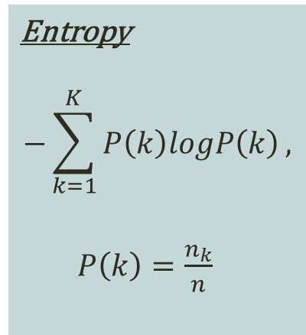
External clustering validation measures
Variation of information
Not based in counting pairs
Entropy
$$−\sum_{k=1}^{K}{P\left(k\right)logP\left(k\right)},$$
$P\left(k\right)=\frac{n_{k}}{n}$
Mutual Information
$$\sum_{k=1}^{K}{\sum_{k^{′}=1}^{K′}{P\left(k,k^{′}\right)log\frac{P(k,k^{′})}{P\left(k\right)P′(k^{′})}}},$$
$P\left(k, k^{′}\right)= \frac{|C_{k}∩{C′}_{k′}|}{n}$
$$\left[ℋ\left(C\right)− ℒ\left(C,P\right)\right]+[ℋ\left(P\right)−ℒ\left(C,P\right)]$$
Author(s):
Marina Meila
Notes:
Entropia é a incerteza sobre um dado ponto estar num cluster especifico
Informação mútua mede a informação que um clustering tem sobre o outro

Slide 11
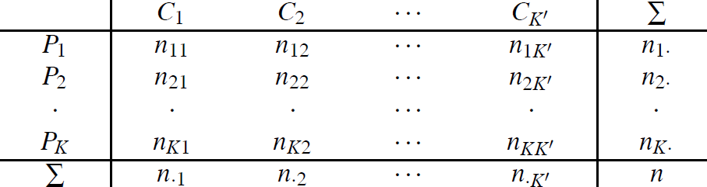
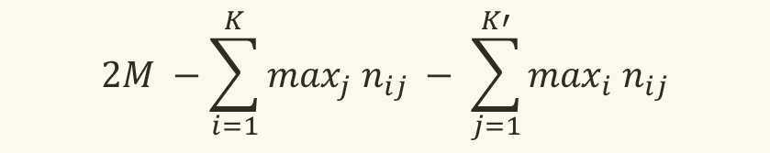
External clustering validation measures
Van Dongen
$$2M −\sum_{i=1}^{K}{\max_{j} n_{ij} − \sum_{j=1}^{K′}{\max_{i} n_{ij}}}$$
Author(s):
Silke Wagner et al.
Notes:
Baseado na interseção máxima entre clusters
Para o calculo usamos uma matriz de contingencia

Slide 12
Related Work
Methods of Evaluation
External Clustering Validation Measures
Internal Clustering Validation Measures
Relative Clustering Validation Measures

Slide 13
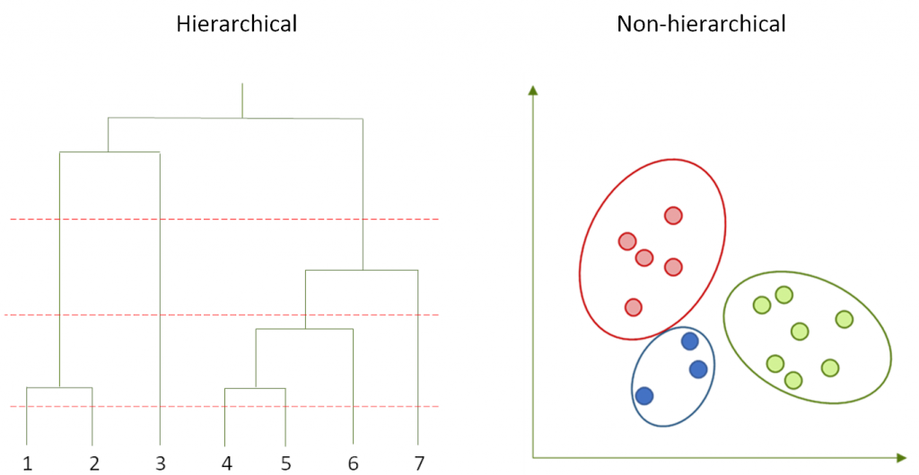
internal clustering validation measures
Clustering Algorithm
DATASET
Proximity Matrix
COMPARASION
Author(s):
Hui Xiong et al.
Notes:
-O objectivo é comparar o resultado do clustering com o dataset

Slide 14
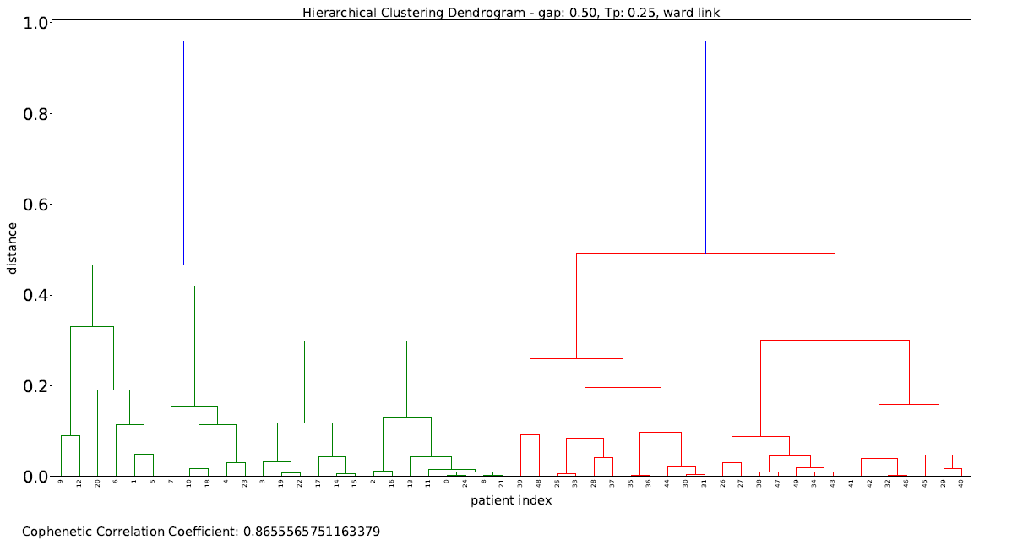
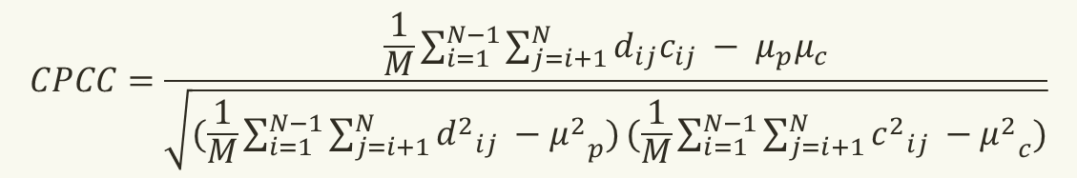
internal clustering validation measures
1. Validating hierarchy of clustering schemes
Cophenetic Matrix (C)
Proximity Matrix (P)
$$CPCC=\frac{\frac{1}{M}\sum_{i=1}^{N−1}{\sum_{j=i+1}^{N}{d_{ij}c_{ij} − μ_{p}μ_{c}}}}{\sqrt{(\frac{1}{M}\sum_{i=1}^{N−1}{\sum_{j=i+1}^{N}{{d^{2}}_{ij} −{μ^{2}}_{p})}}(\frac{1}{M}\sum_{i=1}^{N−1}{\sum_{j=i+1}^{N}{{c^{2}}_{ij} −{μ^{2}}_{c})}}}}$$
Monte Carlo techniques should also be used
Author(s):
Maria Halkidi et al.
Notes:
-A partir do dendrograma produzido pelo hierarchical clustering, pode ser obtida a cophenetic matrix que o representa.
-Para avaliar o clustering Podemos comparar a cophenetic matrix com a proximity matrix
-M é o número maximo de pares e N é o número de pontos no dataset.
-Monte Carlo techniques ou bootstrapping é usado para gerar subconjuntos dos dados, de onde obtemos P.

Slide 15
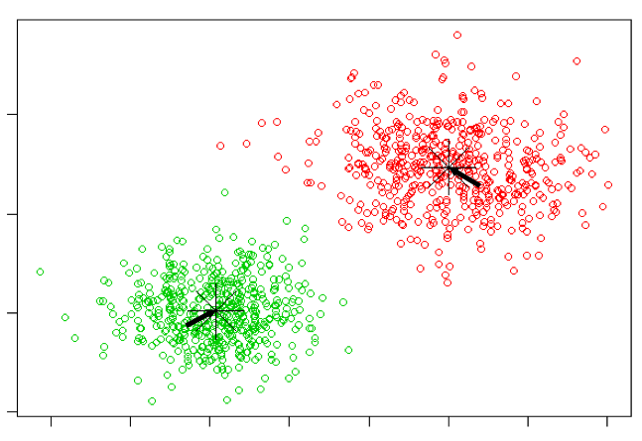
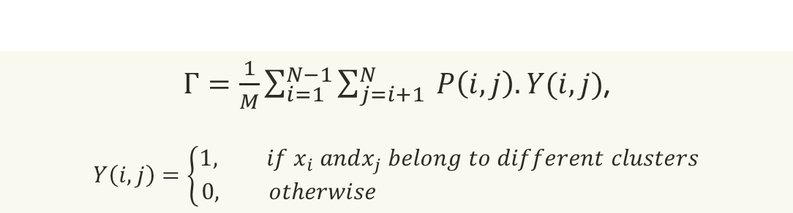

internal clustering validation measures
2. Validating a single clustering scheme
Clustering scheme with $n_{c}$ clusters (C)
Proximity Matrix (P)
$Γ=\frac{1}{M}\sum_{i=1}^{N−1}{\sum_{j=i+1}^{N}{ P\left(i,j\right).Y(i,j)}}$,
$$Y\left(i,j\right)=\left\{\begin{aligned}1, if x_{i} andx_{j} belong to different clusters \\ 0, otherwise \end{aligned}\right.$$
Monte Carlo techniques should also be used
Author(s):
Sergios Theodoridis et al.
Notes:
-O objectivo é encontrar o grau de concordância entre o clustering, C, e matriz de proximidade dos dados,P.
-Usamos a estatistica de Huberts para medir o grau de correspondencia entre Y (obtida através do clustering) e P.
-Monte Carlo techniques ou bootstrapping é usado para gerar subconjuntos dos dados, de onde obtemos P.

Slide 16
Related Work
Methods of Evaluation
External Clustering Validation Measures
Internal Clustering Validation Measures
Relative Clustering Validation Measures

Slide 17

relative clustering validation measures
External and Internal
Statistical Tests
High Computational Resources
RELATIVE
Produce many clustering
Keep using the same algorithm but vary parameters
Choose the clustering that best fits the data
Author(s):
Anil Jain et al.
Notes:
-Medidas relativas são uma boa opção, muito porque os teste estatisticos nas medias externas e internas podem ser muito dispendiosos em termos computacionais

Slide 18
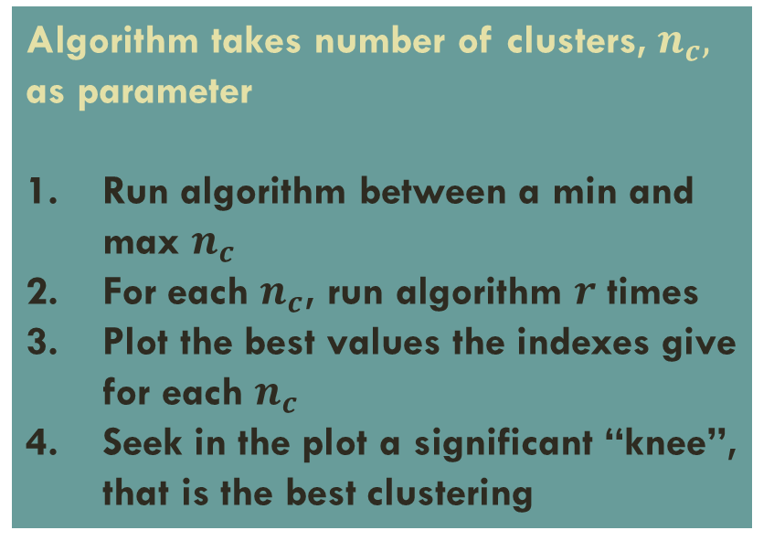
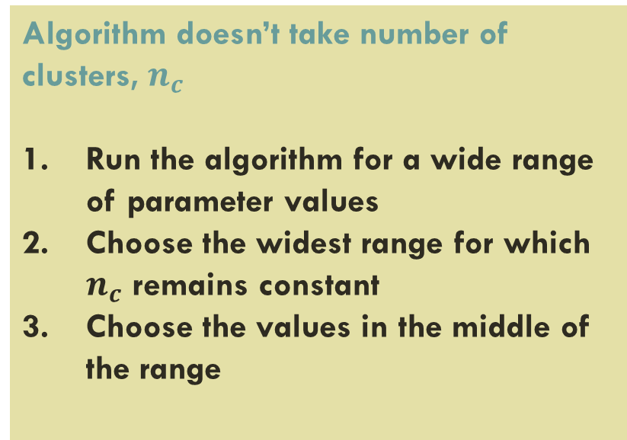
relative clustering validation measures
Algorithm doesn’t take number of clusters, $n_{c}$
Run the algorithm for a wide range of parameter values
Choose the widest range for which $n_{c}$ remains constant
Choose the values in the middle of the range
Algorithm takes number of clusters, $n_{c},$ as parameter
Run algorithm between a min and max $n_{c}$
For each $n_{c}$, run algorithm $r$ times
Plot the best values the indexes give for each $n_{c}$
Seek in the plot a significant “knee”, that is the best clustering
Author(s):
Sergios Theodoridis et al.
Notes:
- Podemos considerar dois casos para medidas relativas

Slide 19
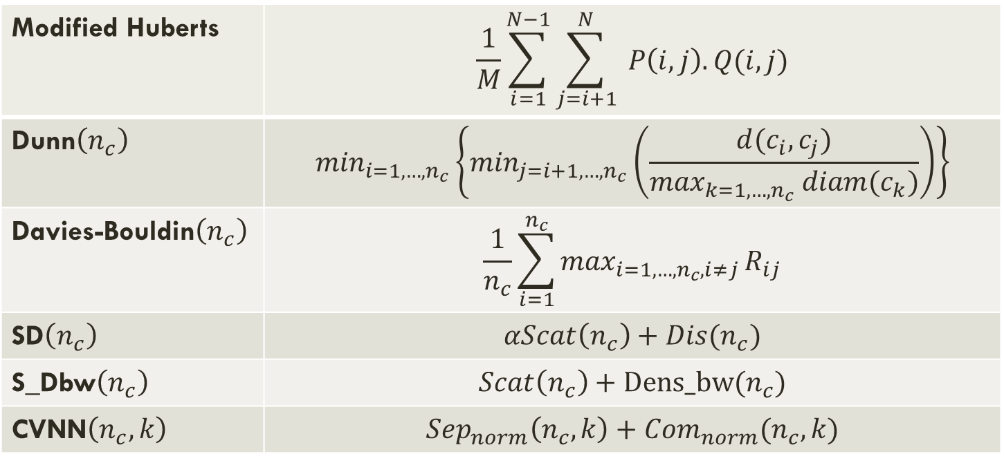
relative clustering validation measures
Modified Huberts | $$\frac{1}{M}\sum_{i=1}^{N−1}{\sum_{j=i+1}^{N}{ P\left(i,j\right).Q(i,j)}}$$
Dunn$\left(n_{c}\right)$ | $$\min_{i=1,…,n_{c}}\left\{\min_{j=i+1,…,n_{c}}\left(\frac{d(c_{i}, c_{j})}{\max_{k=1,…,n_{c}} diam(c_{k})}\right)\right\}$$
Davies-Bouldin$\left(n_{c}\right)$ | $$\frac{1}{n_{c}}\sum_{i=1}^{n_{c}}{\max_{i=1,…,n_{c}, i≠j}}R_{ij}$$
SD$\left(n_{c}\right)$ | $$αScat\left(n_{c}\right)+Dis(n_{c})$$
S_Dbw$\left(n_{c}\right)$ | $$Scat\left(n_{c}\right)+Dens_bw(n_{c})$$
CVNN$\left(n_{c},k\right)$ | $${Sep}_{norm}\left(n_{c},k\right)+{Com}_{norm}(n_{c}, k)$$
Author(s):
Yanchi Liu et al.

Slide 20
Proposed Solution
Extend the validation measurements in AliClu
Apply extended metrics in the algorithm
Publish the measures in a public Python library

Slide 21
Preliminary Results
Appliance of 3 new indices in AliClu

Slide 22
New metrics
CVNN
S_Dbw
Van Dongen
Achieved good results and very new indexes
There was not any relative validation metric
Achieved good results
Comparison with other external metrics

Slide 23

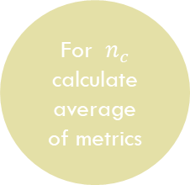
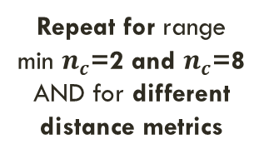
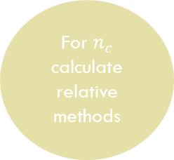
Procedure
Generate Synthetic Dataset
Generate M samples
Run clustering algorithm for each sample
For $n_{c}$ calculate average of metrics
Pre-Process Data
Run clustering algorithm
For $n_{c}$ calculate relative methods
Choose $n_{c}$ with the best results overall
Repeat for range min $n_{c}$=2 and $n_{c}$=8 AND for different distance metrics

Slide 24
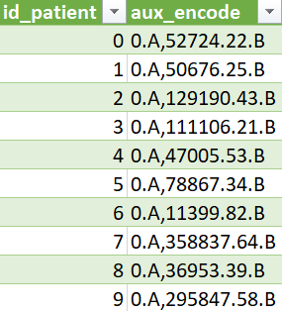
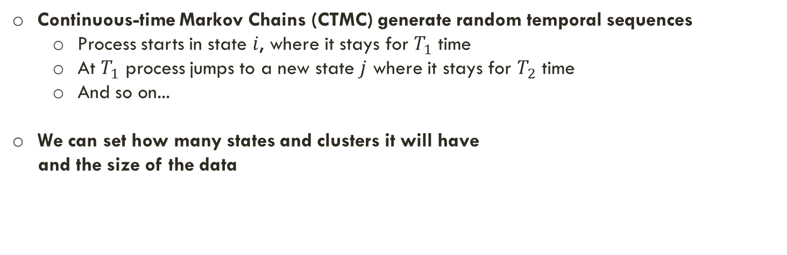
Synthetic Dataset Generation
Continuous-time Markov Chains (CTMC) generate random temporal sequences
Process starts in state $i$, where it stays for $T_{1}$ time
At $T_{1}$ process jumps to a new state $j$ where it stays for $T_{2}$ time
And so on...
We can set how many states and clusters it will have
and the size of the data
Experiment
30 observations
3 clusters
2 states (A, B)

Slide 25
How decision is made
In preliminary experiment, all indexes have the same weight
Consensus
Index 2
weight
Index 3
weight
Index 4
weight
Index 1 weight

Slide 26
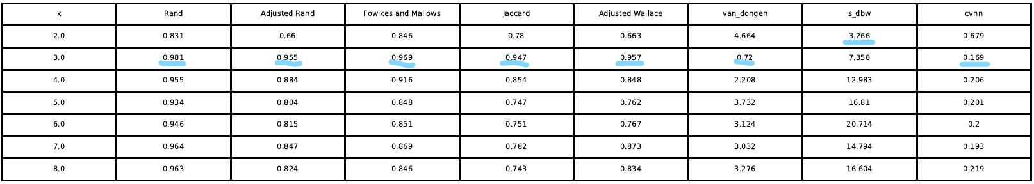
Ward Distance

Slide 27
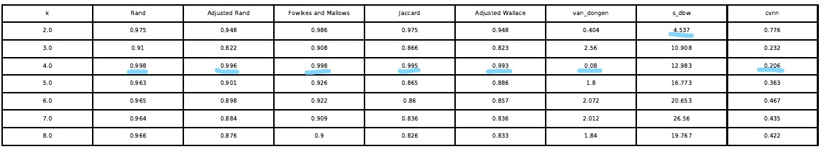
Single Distance

Slide 28
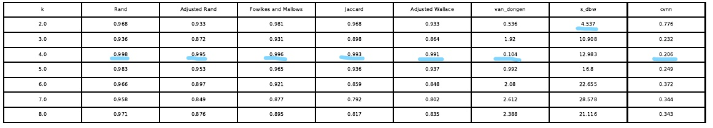
Complete Distance

Slide 29
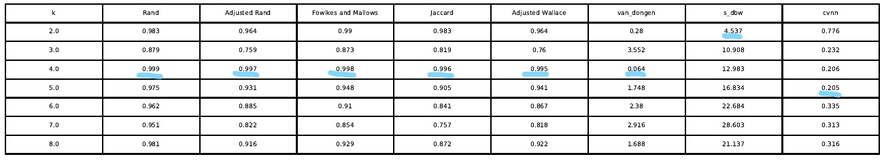
Average Distance

Slide 30
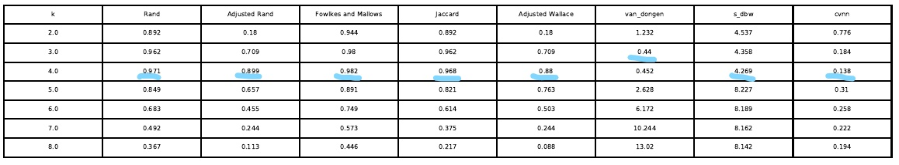
Centroid Distance

Slide 31

Final notes
Results are not satisfctory.
Tests were not extensive, only one run for each distance was made
Algorithm was slower than expected, maybe because of operative system. In Linux runs much better than in Windows
For the future
Although not presented, i would like to point out that as of this moment algorithm is faster, dozens of tests have been made and the results, especially for long sequences with many observations, are better than before.
Progress is being made.

Slide 32
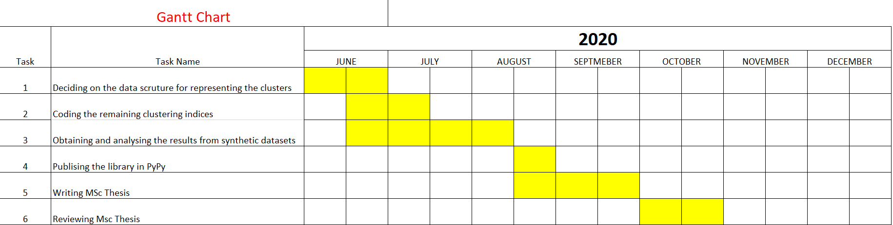
Work Planning
Notes:
Para concluir dizer que agora com os objectivos de trabalho definidos e ainda que o trabalho feito até agora tenha resultados um pouco desapontantes, foi possivel encontrar muitas referências que apoiam a matéria aqui discutida e que confio que vão ajudar-me a vencer este obstaculo do clustering de dados clinicos.
Muito obrigado pelo vosso tempo

